Slide 1
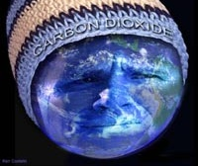
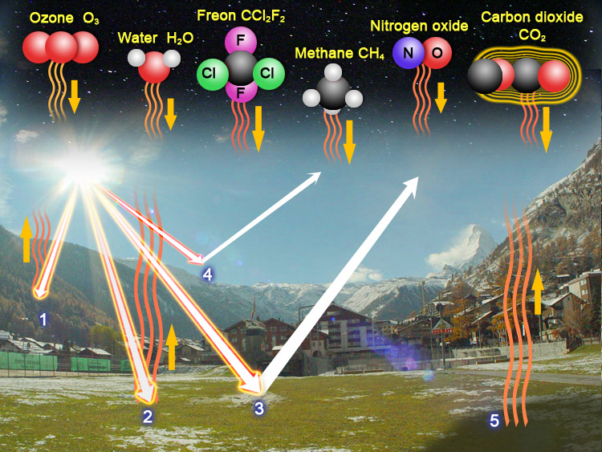
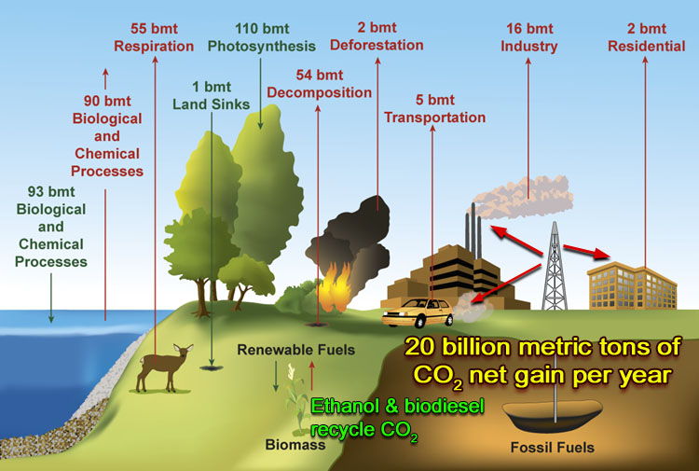
Lab 5:
Global Warming
Energy from the sun follows different paths. Starting with #1 ray of light, we see it entering the atmosphere and being absorbed by the air. Some of this heat radiates back to space. The #2 ray of sunlight hits the ground and heats the ground. Some of this heat radiates back up to space. The #3 ray reflects off the ground and goes back into space. The #4 ray gets reflected back to space by particles in the atmosphere. (#5) Even where the sun isn't shining, heat is radiating out to space. In other words, a lot of energy hits the Earth but the Earth either reflects the heat or radiates heat back into space. Without some way of returning this heat going up into space, the Earth would be a frozen wasteland. Fortunately, we have some gases in the air which intercept this energy and radiate much of it back to the ground.
Carbon dioxide and methane are the two gases that contribute the most to global warming. Both of these are produced by nature and man.
This graphic illustrates what happens to carbon dioxide. The "bmt" units stand for billion metric tons. 2,200 lbs is 1 metric ton. So one bmt= (2,200,000,000,000 lbs).
The best estimate is that an extra 20 billion metric tons of CO₂ are added to atmosphere each year. That’s mostly coming from burning fossil fuels. In this lab we will detect CO₂.
Notes:
Red water is the Jianhe River in Luoyang, Henan province Dec. 13, 2011. Two chemical plants upstream.

Slide 2
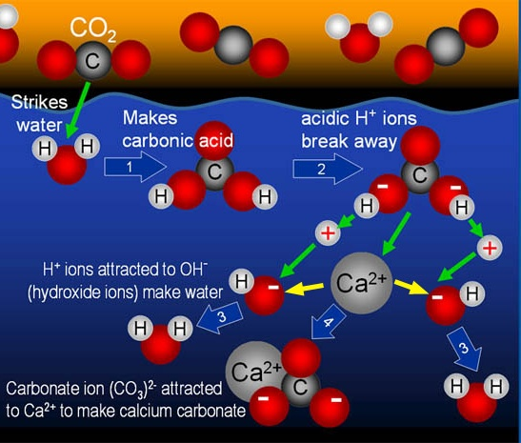
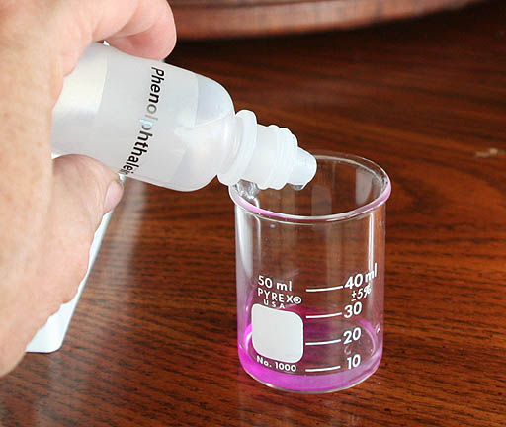
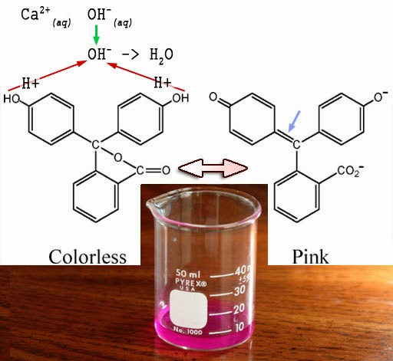
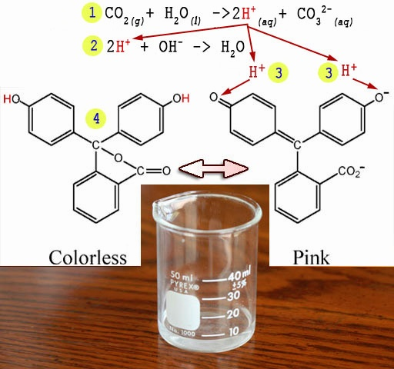
Lab 5: Global Warming: Detection of CO₂
Detection of CO₂ due to neutralizing of OH⁻ ions: First calcium hydroxide, Ca(OH)₂, is added to water so that it dissolves into calcium ions (Ca²⁺) and hydroxide ions (OH⁻). See yellow arrows.
Ca(OH)₂ → Ca²⁺ + 2OH⁻
This makes water alkaline due to excess OH⁻ ions.
(1) CO₂ dissolves in water and some of it combines with water molecules to form carbonic acid (H₂CO₃).
CO₂ + H₂O → H₂CO₃
(2) The hydrogen atoms on carbonic acid break away forming acidic H⁺ ions and carbonate (CO₃²⁻ ) ions.
H₂CO₃ → 2H⁺ + CO₃²⁻
(3) H⁺ ions combine with the OH⁻ ions to form water.
H⁺ + OH⁻ → H₂O (can also be written as HOH).
This removes OH- ions, which reduces alkalinity.
(4) Ca²⁺ ions combine with CO₃²⁻ ions to form solid particles of CaCO₃ (calcium carbonate)
Ca²⁺ + CO₃²⁻ → CaCO₃
Strategy for detecting CO₂: We will start with a dilute solution (~ 0.03%w/v) of calcium hydroxide, Ca(OH)₂. The solution should be alkaline (basic) due to the excess of OH⁻ ions. We will be checking it with a pH meter to be sure. Also, we can check pH by adding drops of phenolphthalein because it changes to a pinkish purple at pH levels that are alkaline (above 7).
Pink Color: Phenolphthalein has two structures. When clear, it is the left structure. It becomes the right structure and turns pink when the OH⁻ ions from calcium hydroxide (green arrow) pull the hydrogen atoms off of the OH groups (red arrows). When the hydrogen atoms are pulled off, they leave their electrons behind becoming H⁺ ions. The extra electrons cause a shifting of electrons that generates the right-side structure.
Phenolphthalein
Add CO₂ to solution: The next step will be to add CO₂ to the pink solution. One source will be your breath. Another source will be from combustion. Dry ice could be another source.
Pink to Clear: (1) CO₂ combines with water to make acid (H⁺) and carbonate (CO₃²⁻). CO_{2(g)} + H₂O_{(l)} → 2H⁺_{(aq)} + CO₃²⁻_{(aq)}
(2) The acid neutralizes the OH⁻ to form water. 2H⁺_{(aq)} + OH⁻_{(aq)} > H₂O_{(l)}
(3) After all OH- ions are neutralized, extra H⁺ ions reattach to the oxygen atoms on two of the rings.
(4) With the hydrogen atoms reattached, phenolphthalein returns to its colorless form (4).
Note: (g)=gas, (l)=liquid, (aq)=aqueous ( dissolved in water), (s)=solid.
Notes:
"Indonesia-sodis-gross" by SODIS Eawag - Own work. Licensed under CC BY 3.0 via Commons - https://commons.wikimedia.org/wiki/File:Indonesia-sodis-gross.jpg#/media/File:Indonesia-sodis-gross.jpg For sunlight sterilization of water.

Slide 3
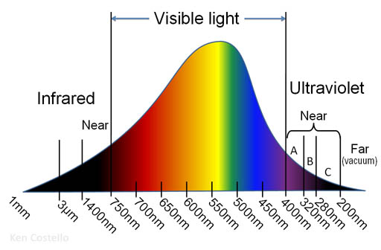
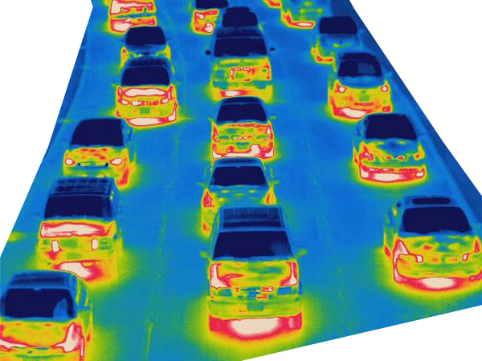
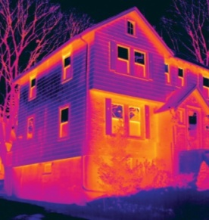
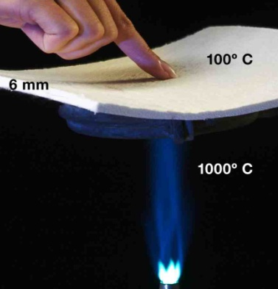
Lab 5: Global Warming: Coping with high temperatures
There’s a good chance that we will not do enough to stop high speed global warming. In that case, we will have to deal with it. Climate change experts in Arizona predict that Arizona will have a 10°F rise in temperature. So instead of just a scorching 118°F temperatures in the summer, they could be 128°F. The current record for Phoenix is 122°F, which could easily become 132°F. At those temperatures, our plants may not survive and our cars will overheat. Also, the A/C in our houses will not be able to keep up. Plus power companies will likely not be able to provide enough power resulting in blackouts. We need to prepare for that. Even if it doesn’t get that hot, our preparation will still save us money and give us more comfort.
To protect against the sun, our car and home windows should allow visible light through but block all of infrared and ultraviolet light because infrared quickly causes items to warm up, and ultraviolet damages skin, eyes, paint, and most materials.
Light Spectrum of the Sun
Thermal Imaging will help sort out hot spots and waste of A/C
Switch to space-age insulation such as Aerogel.
We should
also switch
to electric cars
because they
don’t heat
up the car
or air.
Near Infrared photography will see landscapes that cool
Notes:
"Indonesia-sodis-gross" by SODIS Eawag - Own work. Licensed under CC BY 3.0 via Commons - https://commons.wikimedia.org/wiki/File:Indonesia-sodis-gross.jpg#/media/File:Indonesia-sodis-gross.jpg For sunlight sterilization of water.

Slide 4
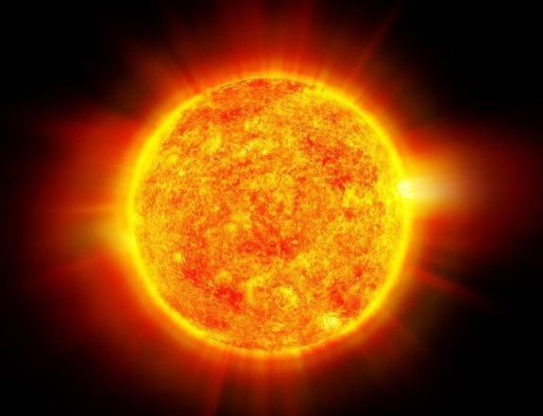
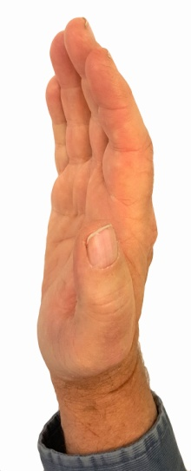
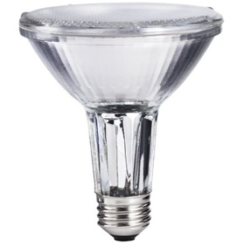
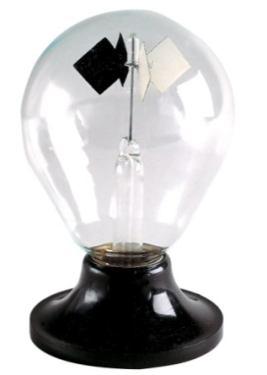
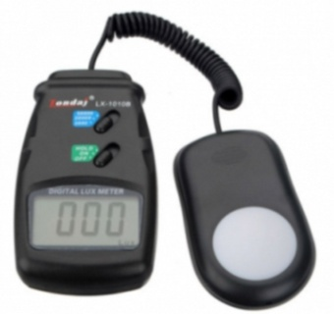
Lab 5: Global Warming: Blocking Infrared radiation
The best windows or window film for hot climates are those that allow visible light into the home (or office) but block the infrared light, which adds heat. It should also block UV light, which causes damage to home furnishings and to eyes and skin.
Below is a diagram of how it should work.
← Infrared ←
Infrared → →
Visible light → →
Ultraviolet → →
← Ultraviolet ←
Measuring window film properties: In this experiment you will use an incandescent light bulb that will simulate the light from the Sun. It matches the Sun because a lot of the light it emits is infrared light. You will test glass with solar window film, foil, and other materials. Your measurements and observations will be based on the below tools and perhaps a few others.
Glass with solar blocking material
Your Hand
Incandescent
Light Source
Radiometer
Infrared thermometer
Light Meter
Measuring window film properties (continued): On the next page you will record how the solar blocking material performed. For the Radiometer, list its spinning rate as Fast, Medium, Slow, or Stopped. This mostly measures infrared light. For the Light Meter, list the visible light level in Lux. For the hand, report the sense of heat as hot, medium, or cool. For the infrared thermometer, report the temperature of a black object behind the glass in Fahrenheit and Celsius.

Slide 5
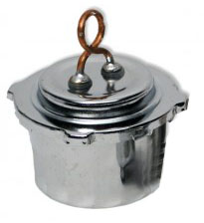
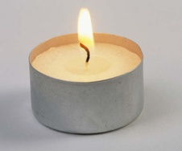
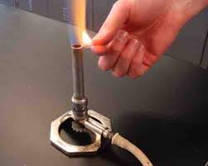
Lab 5: Global Warming: Detection of CO₂
Detecting CO₂ in breath.
Transfer between 10 mL and 15 mL of dilute calcium hydroxide solution to a 50 mL beaker. You can use the markings on the beaker for measurement (no graduated cylinder needed).
Add 2 to 4 drops of phenolphthalein to the solution. The solution should turn purplish pink.
Use your pH meter to measure & report the pH level: __________
Rinse pH meter off with distilled water after checking pH.
Add CO₂ until color change: With the blue tubing (or a straw), use your breath to blow bubbles into the pink solution. Do this for about two minutes (less if the color goes clear).
Check and report the pH at this point: _____________
If the color is not clear, try again for another two minutes. Check and report the pH again: ____________
A change from pink to clear indicates CO₂ was present. Also, a drop in pH value indicates CO₂.
3. Detecting CO₂ from combustion:
Again transfer between 10 mL and 15 mL of dilute calcium hydroxide solution to a 50 mL beaker.
Add 2 to 4 drops of phenolphthalein to the solution. The solution should turn purplish pink.
Use your pH meter to again measure & report the pH level: ________
Rinse pH meter off with distilled water after checking pH.
Carbon based fuels like gasoline, natural gas, or alcohol produce water and carbon dioxide as the products of combustion. Below are reactions for methane (natural gas/CH₄) and rubbing (isopropyl) alcohol (C₃H₈O):
CH₄ + 2O₂ → CO₂ + 2H₂O & 2C₃H₈O + 9O₂ → 6CO₂ + 8H₂O
Add CO₂ until color change: The source to prove that combustion contains CO₂ will either be from an alcohol burner, candle, or Bunsen burner.
Getting the combustion gases to bubble into the solution of calcium hydroxide is rather tricky. The instructor will have a couple of strategies. You may think of something better.
After the solution turns clear, use your pH meter to again measure & report the pH level: ________
Rinse pH meter off with distilled water after checking pH.
Instructor will give you list of items to take home for more testing.
Notes:
"Indonesia-sodis-gross" by SODIS Eawag - Own work. Licensed under CC BY 3.0 via Commons - https://commons.wikimedia.org/wiki/File:Indonesia-sodis-gross.jpg#/media/File:Indonesia-sodis-gross.jpg For sunlight sterilization of water.

Slide 6
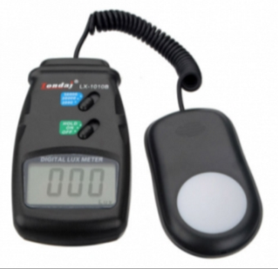
Lab 5: Global Warming: Blocking Infrared radiation
Measuring window film properties: Record the results of tests with these tools.
Glass alone | Solar film | Aluminum | Dry Paper | Wet Paper
Radiometer
Light Meter
Your Hand
Infrared thermometer
Optional fifth tool
Instructor will give you list of items to take home for more testing.

